Slide 1
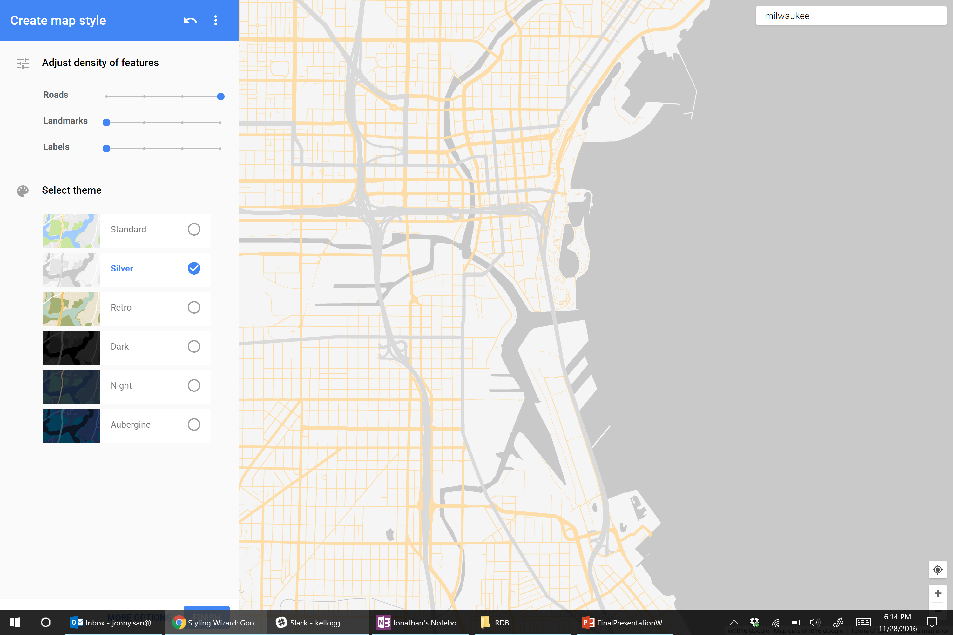
motorcycle curious?
Alex Dadashev · Jesse Delan · Randy Ochs
Sydney Rossman-Reich · Jonny San
Notes:
Greeting & Introductions

Slide 2
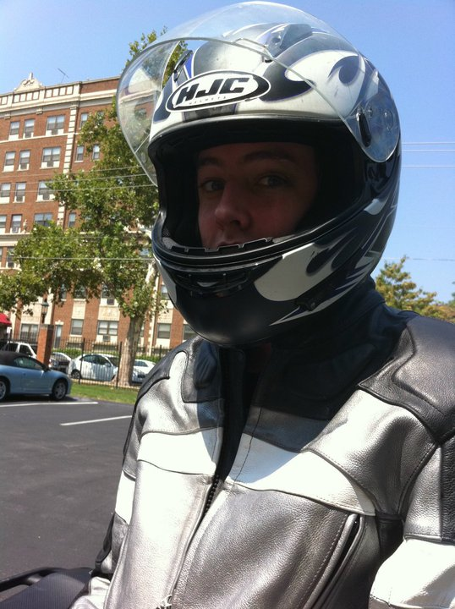
“When I was 16, on a family vacation, I rented a scooter and just tore it up”
“I was in college and looking for ways to gain independence, I remembered that liberating feeling and decided to try motorcycling”
BENTON
28 | Engineer | Florida
Notes:
Who is Benton?
+ 28-year old Engineer living in Fort Lauderdale, FL
+ Avid motorcycle enthusiast, has served as president of local motorcycle club
+ When we asked Benton how he got into motorcycling he said:
-------- When he was 16 he visited Key West with his family. While his parents were shopping, he rented a scooter and “tore it up”. He loved the experience so much (felt free). Later when he met a Harley owner in college, he remembered how free he felt on that scooter and decided to try motorcycling. Bought a bike that summer.

Slide 3
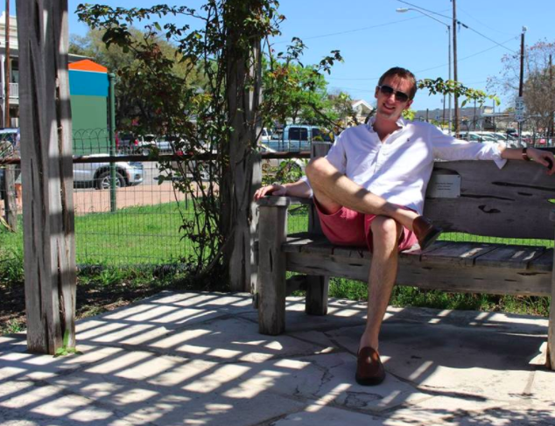
“I haven’t really considered getting on a motorcycle, but I really like motorbikes and scooters and have thought about getting one”
CHRISTOPHER
27 | Product Manager | Texas
Notes:
Who is Chris?
+ 27-year old Product Manager living in Houston, TX
+ When we asked him about motorcycling, he said he wasn’t interested.
+ But when we asked him about motorbiking / mopeding, he expressed serious interest in buying and using one of these bikes

Slide 4
KEY INSIGHT

Slide 5
Many millennials don’t see themselves on motorcycles,
but they do view light two-wheelers as accessible, affordable, and approachable
For millennials, experience on any motorized two-wheeler can be a gateway to motorcycle ridership

Slide 6
A new vehicle alone is not enough to bring millennials to riding

Slide 7
“For my parents, adventure was taking a road trip across the country. For me, it’s exploring my city”
– Brett, 25
“I like technology and I’m comfortable with it”
– Kiki, 24
“There are so many fake brands out there. I won’t buy anything that isn’t authentic”
– Alyssa, 26
“I’ll do it because my friends are doing it”
– Isaac, 13

Slide 8
Accessible
Approachable
friends
technology
adventure
authenticity
Affordable

Slide 9
Accessible
Approachable
Motorcycle
Curious
Affordable
Notes:
RANDY

Slide 10
SOLUTION

Slide 11
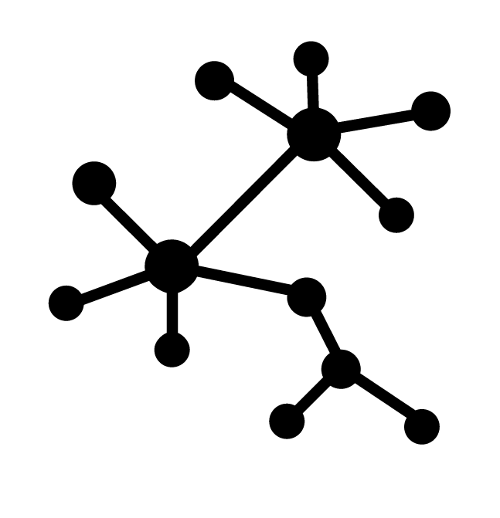

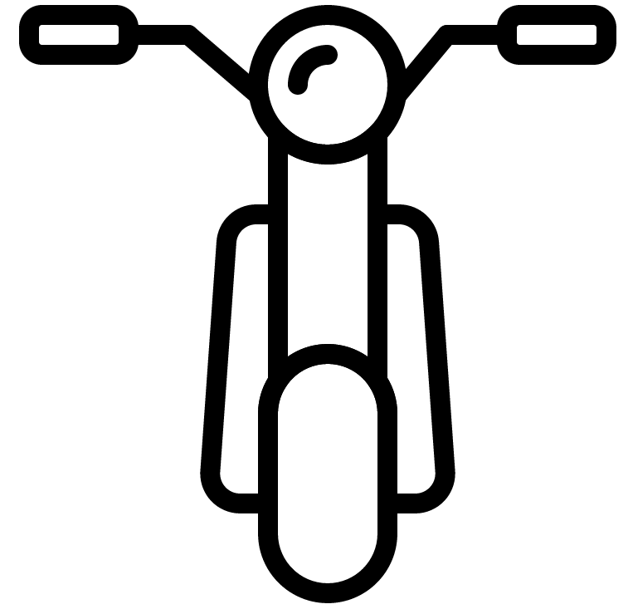
riH-Der
City
Network
Motorized
Offering
Mobile
Experience
A comprehensive digital and physical motorized bike-share system

Slide 12
Accessible
Approachable
Motorcycle
Curious
Affordable
Notes:
.

Slide 13
City Network
City-wide, Harley-branded motorized bike-share
Convenient locations
No motorcycle license
Scalable

Slide 14
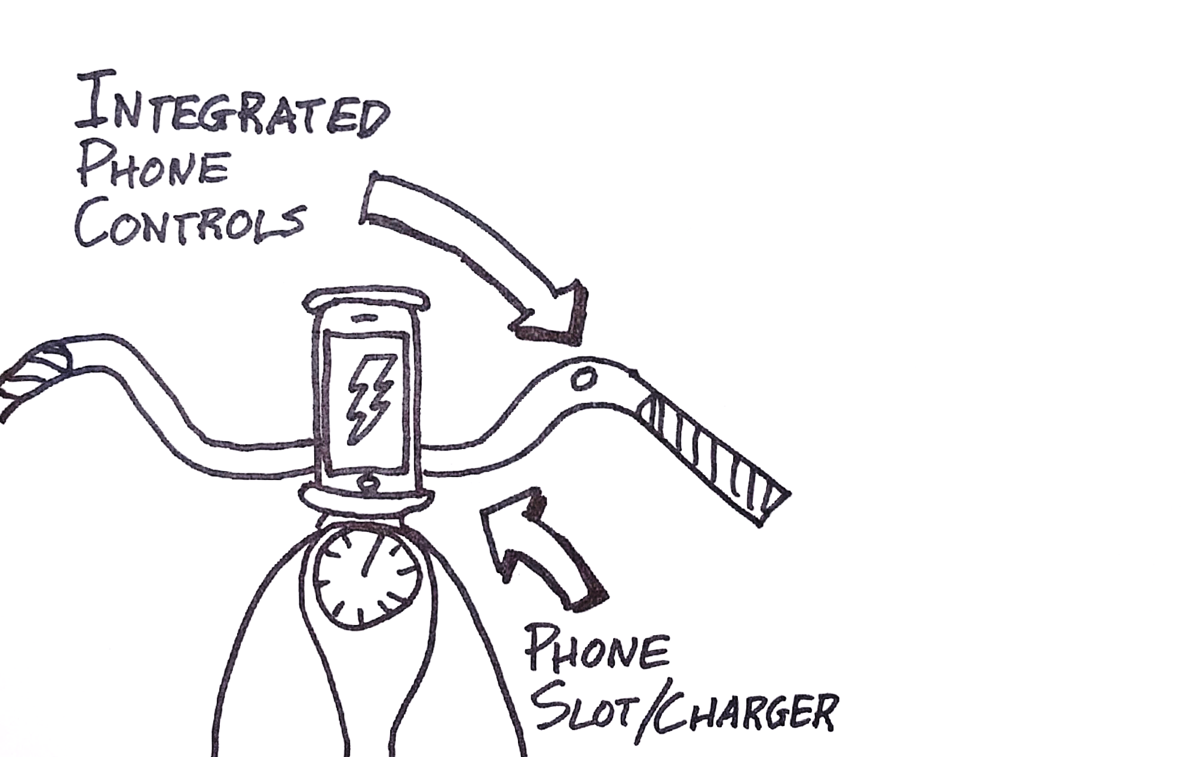
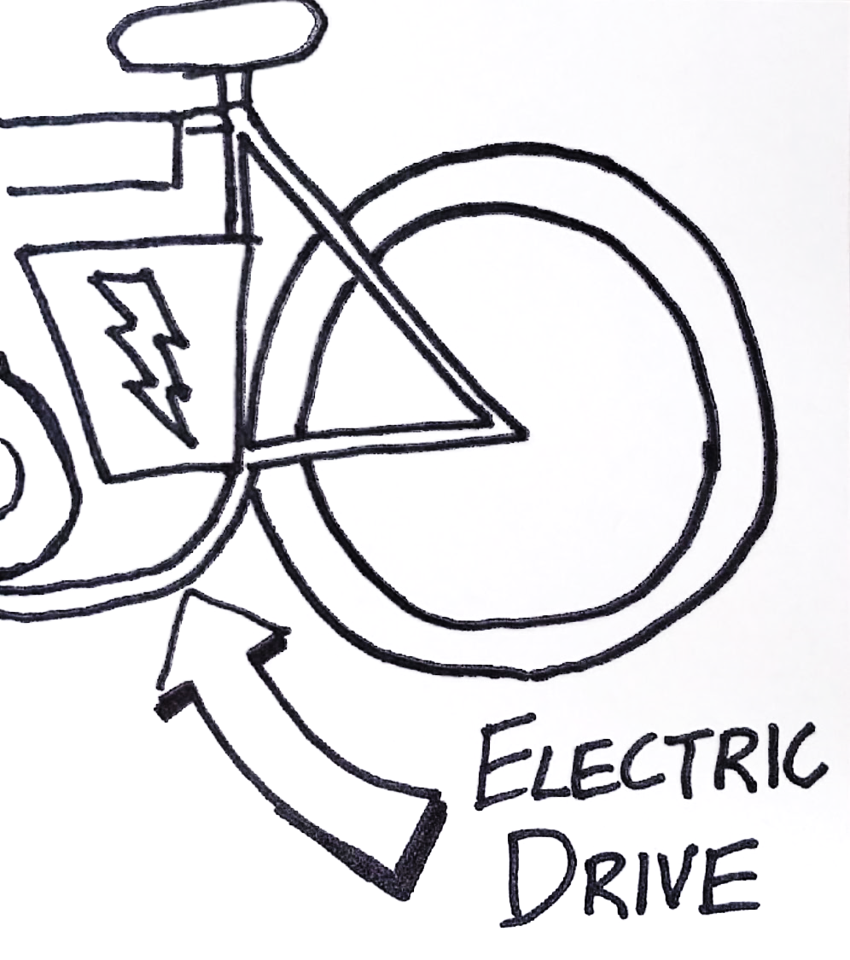
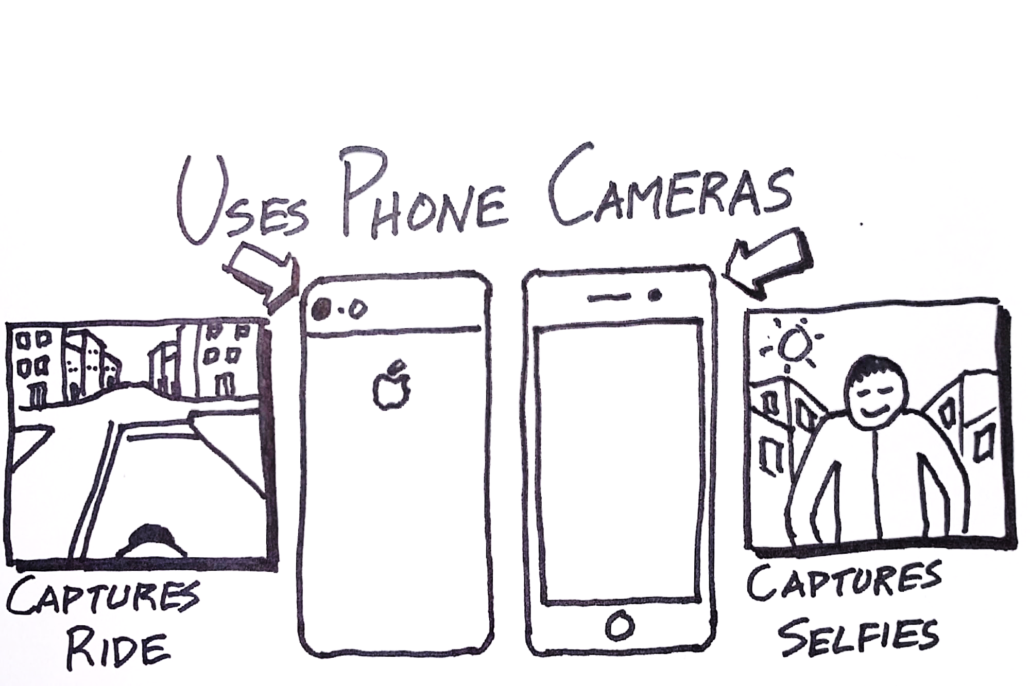
Motorized Offering
Electric drivetrain
Phone slot and built-in charger
Integrated phone controls
Phone camera captures ride
Classic Harley-Davidson styling

Slide 15
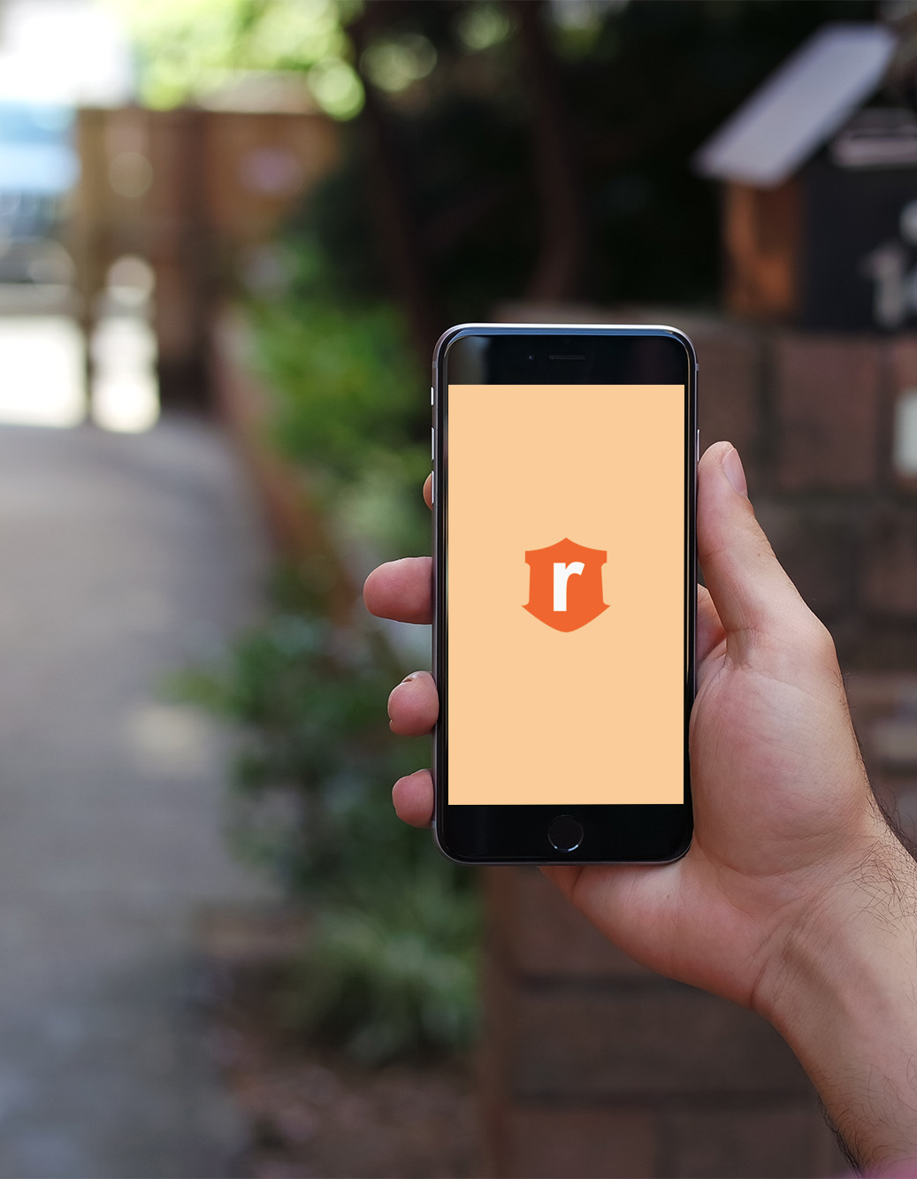
Mobile Experience
App-based moped-share experience
Moped-station locator
Seamless check out and payment
Social newsfeed of other riders
In-app promotions

Slide 16
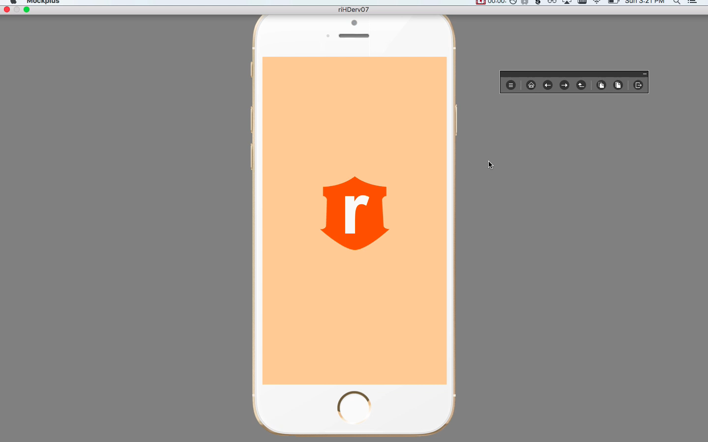

Slide 17
CUSTOMER JOURNEY

Slide 18
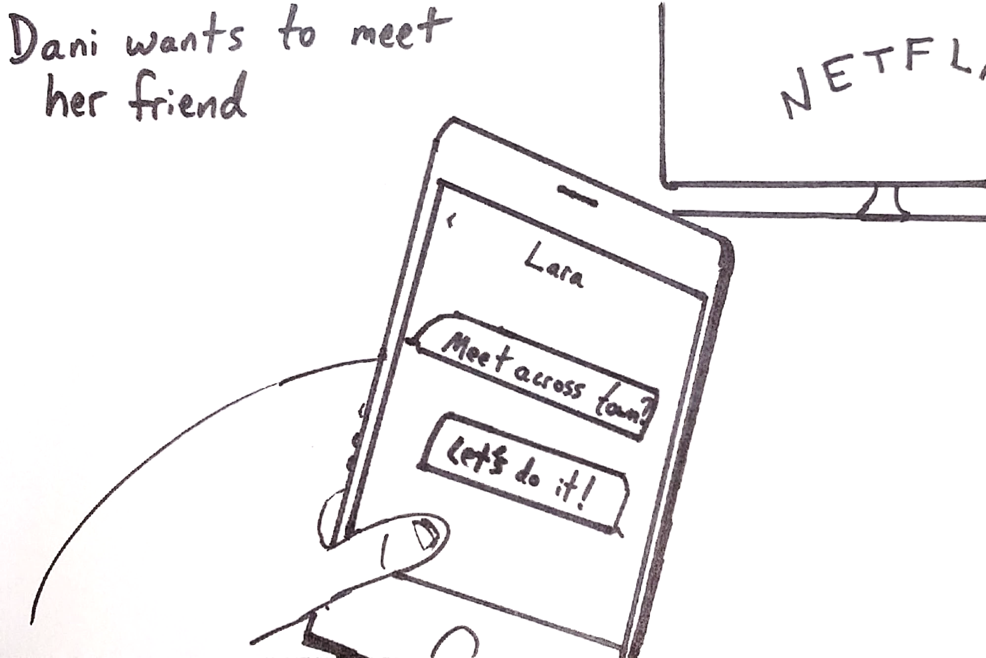

Slide 19
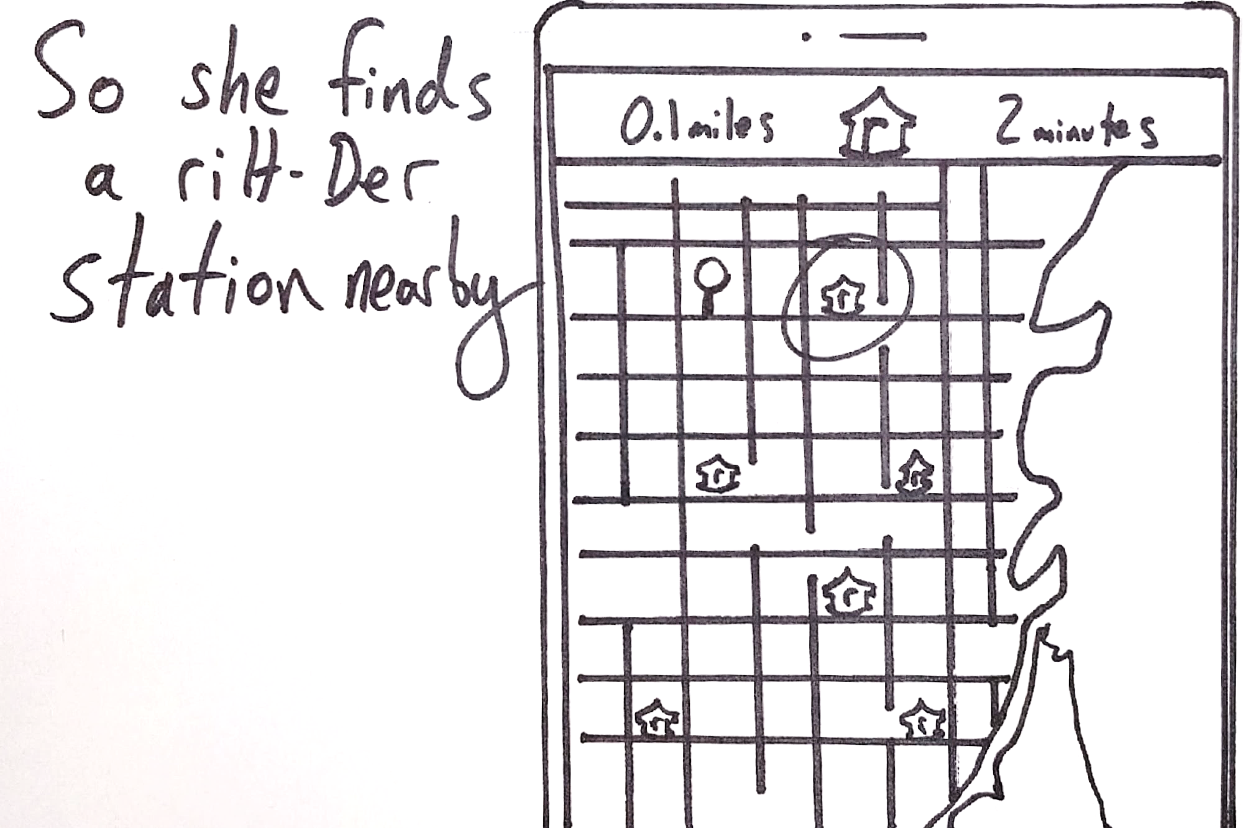

Slide 20
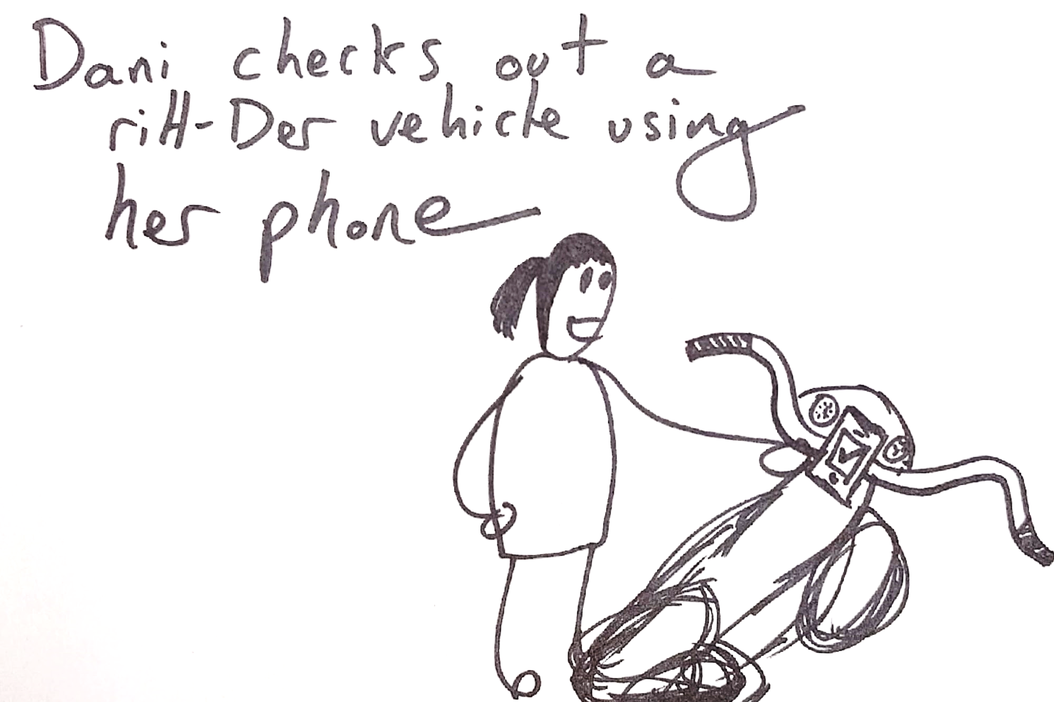

Slide 21
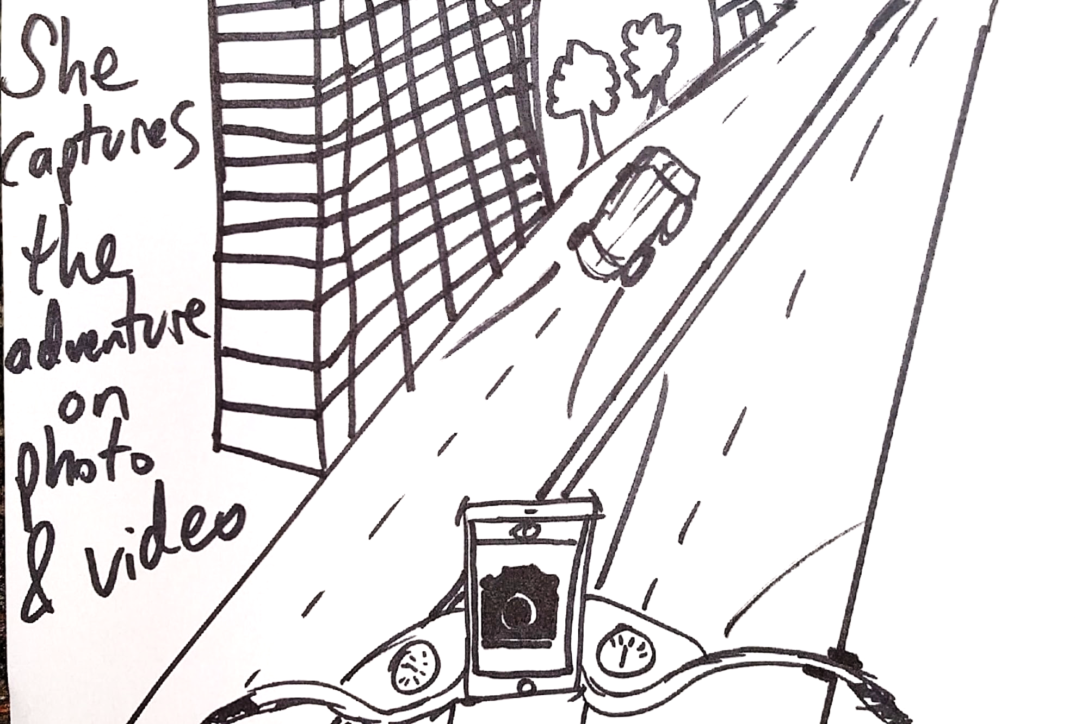

Slide 22
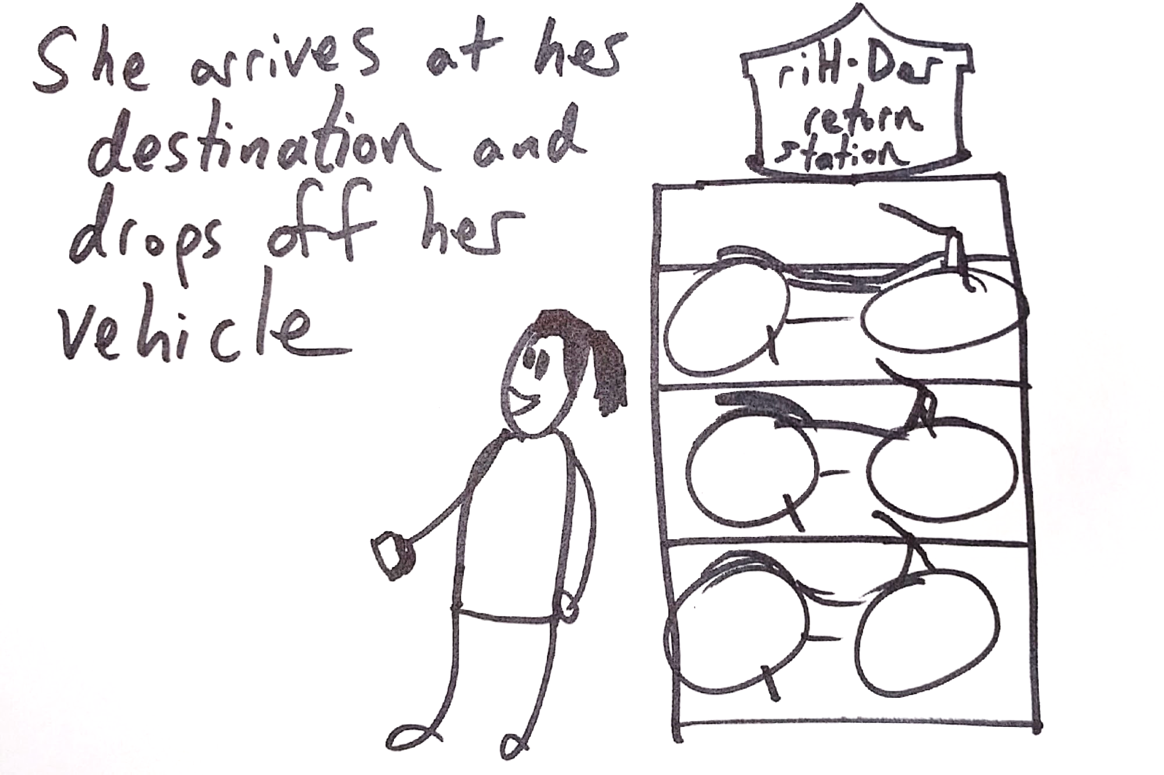

Slide 23
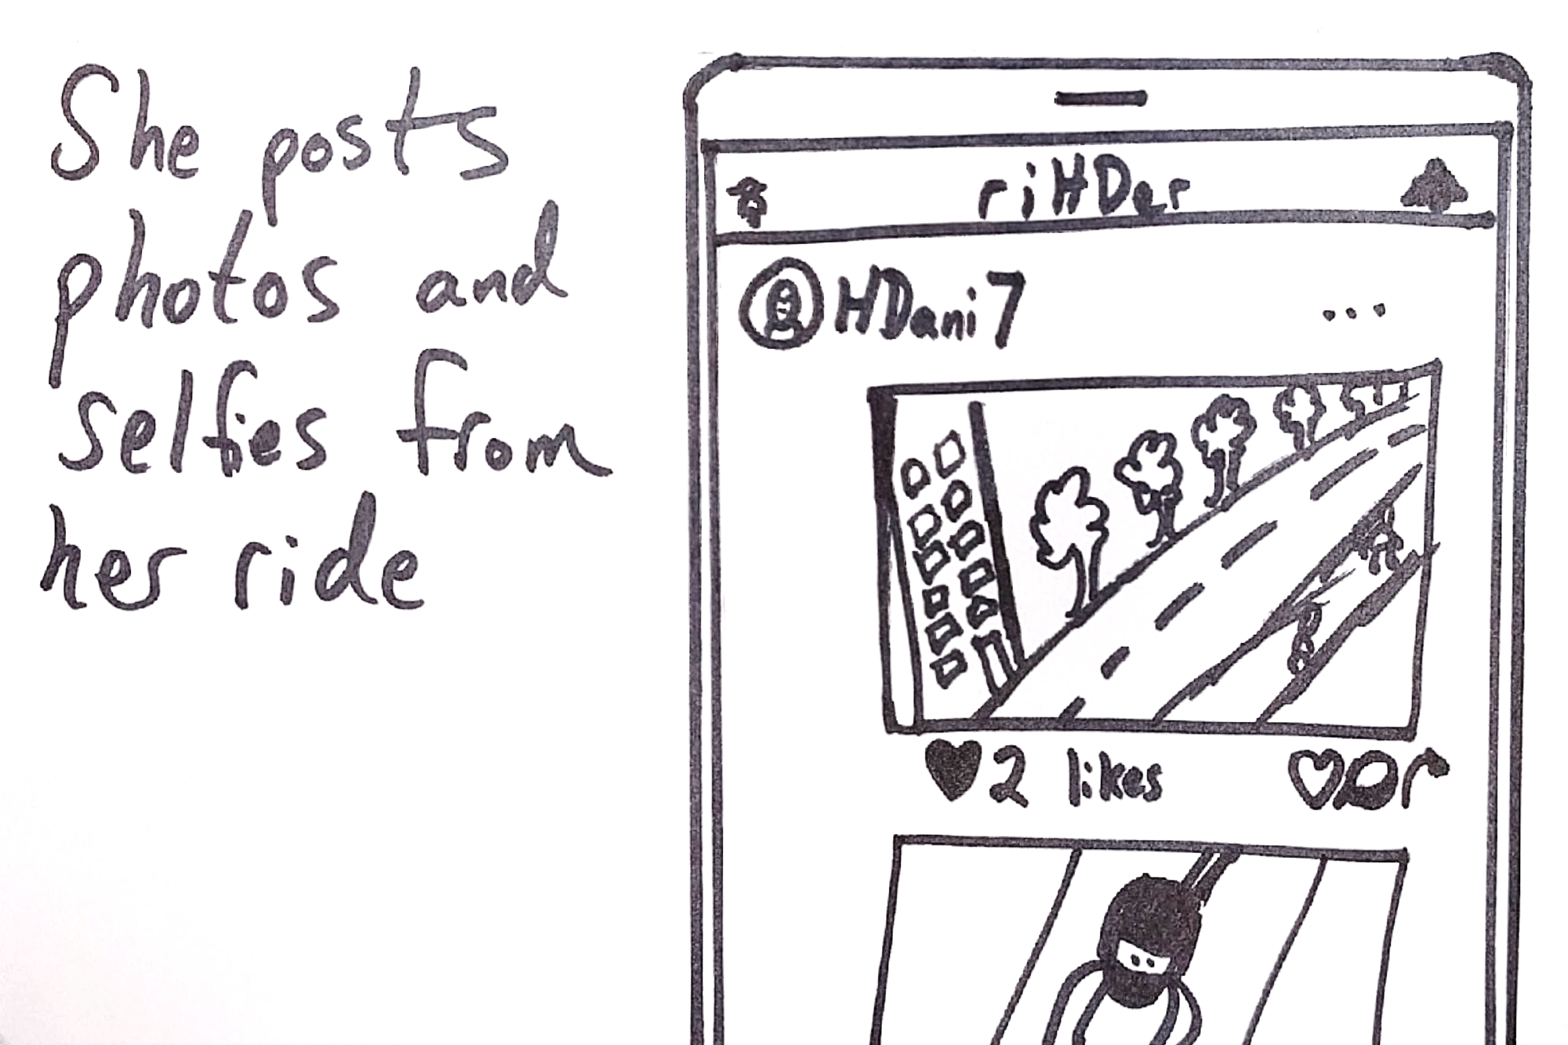

Slide 24
SYNTHESIS

Slide 25
Accessible
Approachable
Motorcycle
Curious
Affordable

Slide 26
Accessible
Approachable
Affordable

Slide 27
REASONS TO BELIEVE
Notes:
SYDNEY

Slide 28
DESIRABILITY
“I’m not willing to spend a lot of money on transportation. This seems like a cheap way to get around my city.”
– Chris, 27
“Sounds like an easy way to see the city”
– Stefan, 26
“I like the camera. It reminds me of Snapchat”
– Kristin, 26

Slide 29



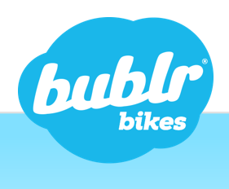



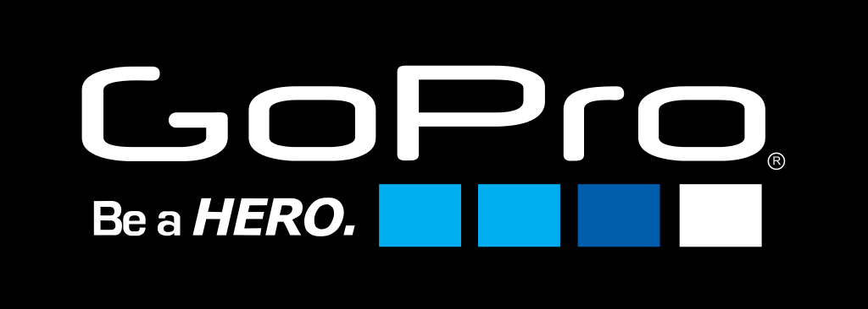
FEASIBILITY
Cities are open to ridesharing
Potential partners are available
The technology already exists

Slide 30
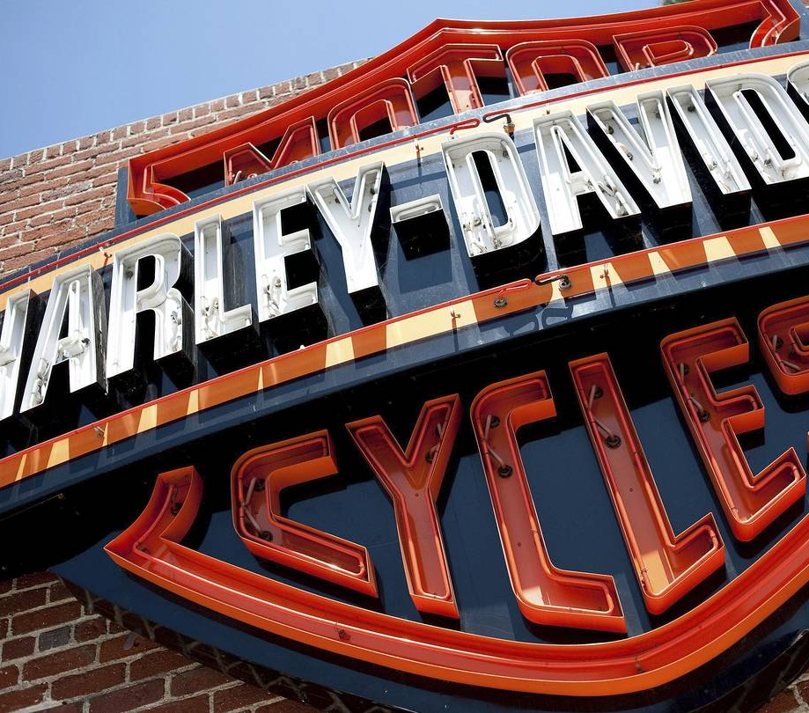
VIABILITY
Easy to pilot
Social aspect fuels growth
Self-sustaining ecosystem

Slide 31
Roll-out Strategy
Pilot
Expand
Evolve
Create 5+ test stations
Develop basic mobile app
Design motorized offering
Secure city partners
Track demand
Add stations
Build out mobile experience
Integrate additional partners
Continue scaling
Consider selling motorized offering
Convert riH-Ders to motorcycling

Slide 32
riH-Der curious?
Alex Dadashev · Jesse Delan · Randy Ochs
Sydney Rossman-Reich · Jonny San

Slide 33
Appendix

Slide 34
Millennials Have High Trust in What Their Friends & Family Say, and Don’t Believe in Traditional Advertising
89%
Of millennials trust recommendations from friends and family more than claims by the brand
Kissmetrics
16%
Of millennials trust traditional advertising
Hubspot

Slide 35
Millennials Care About Social Media. A Lot.
84% of millennials report that user generated content of company websites at least somewhat influences what they buy
Bazaarvoice
44% of millennials are willing to promote products or services through social media in exchange for rewards
Aimia
Millennials are 247% more likely to be influenced by blogs or social networking sites, than advertisements
Hubspot

Slide 36
Millennials’ Trust in Various Forms of Media
Source: Ipsos, Crowdtap

Slide 37
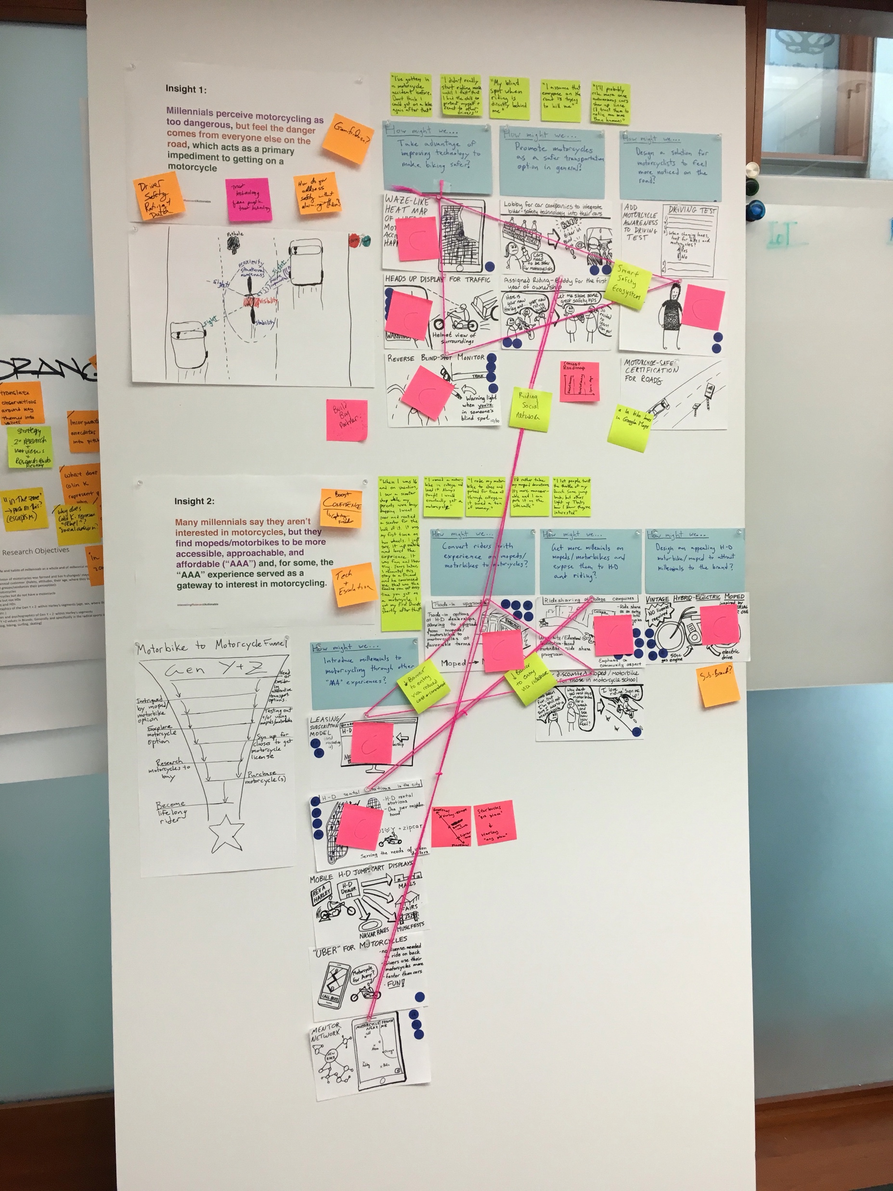

Slide 39
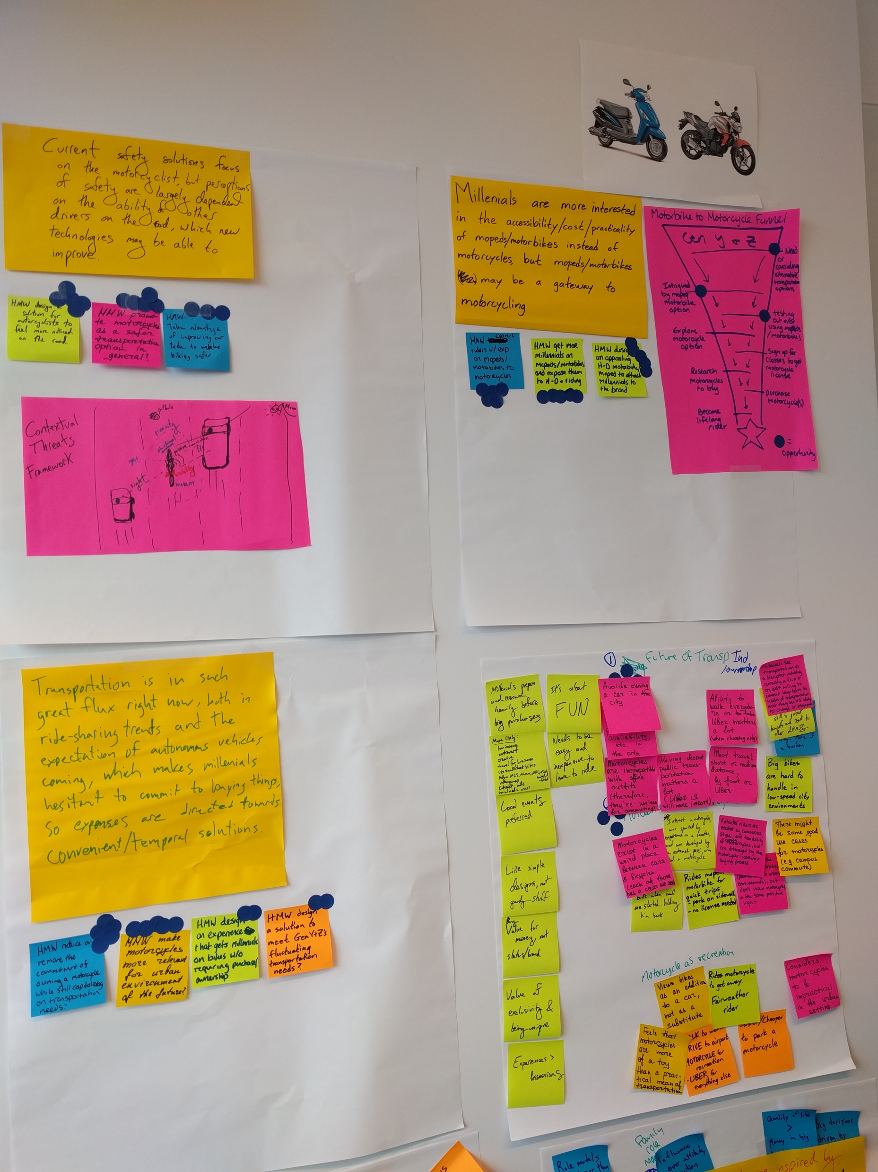

Slide 40
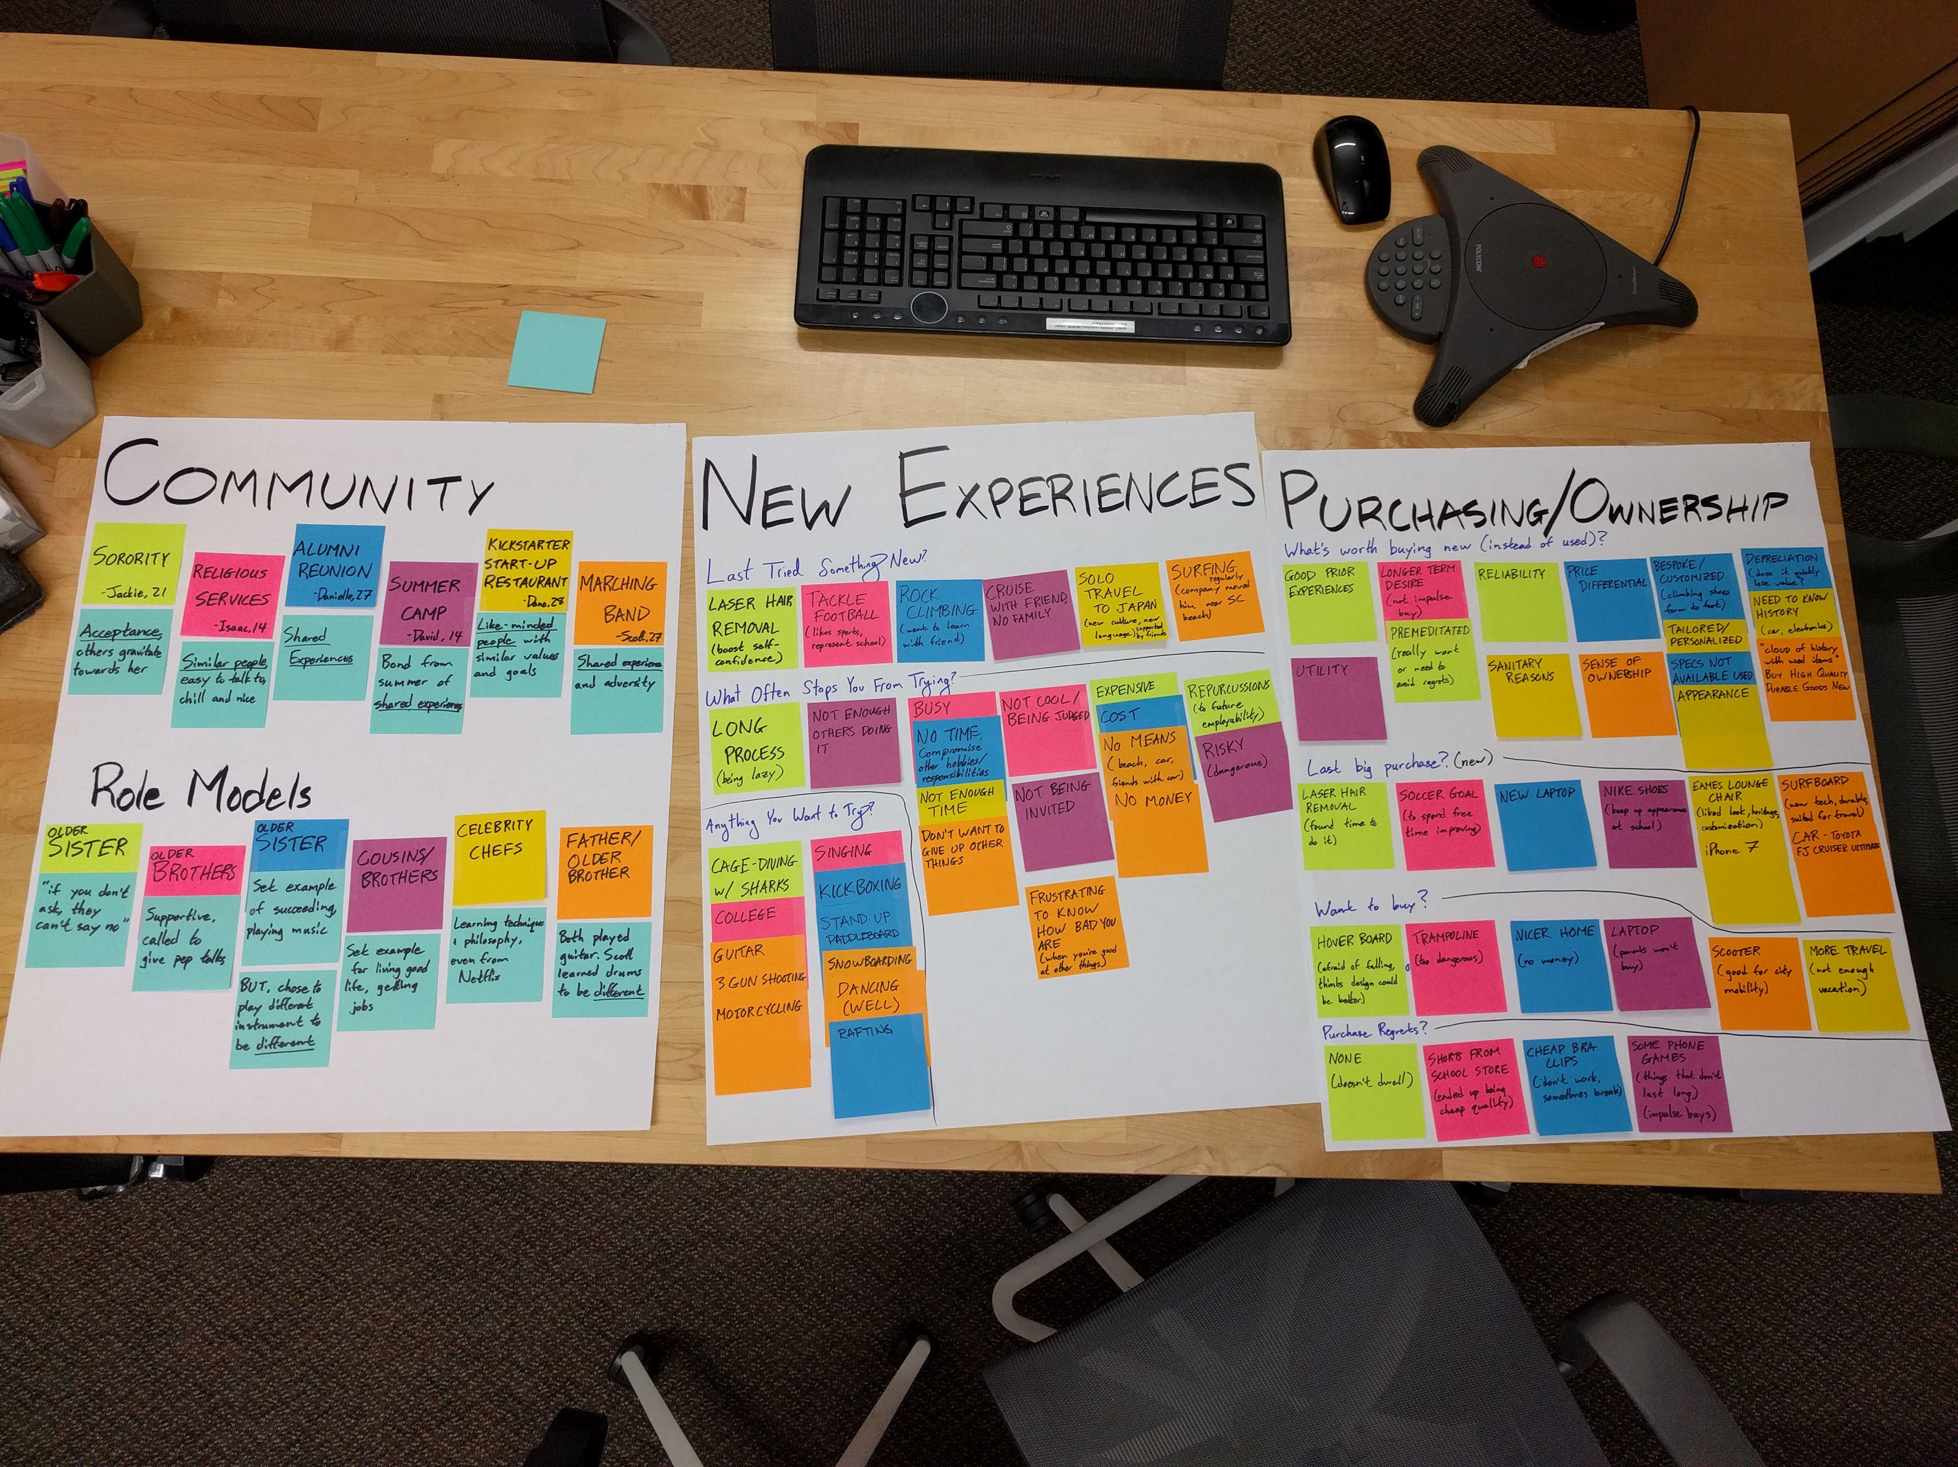

Slide 41
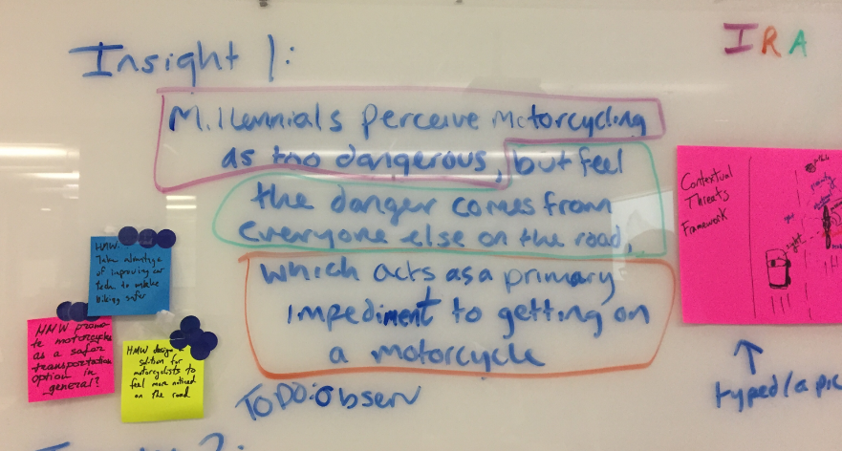
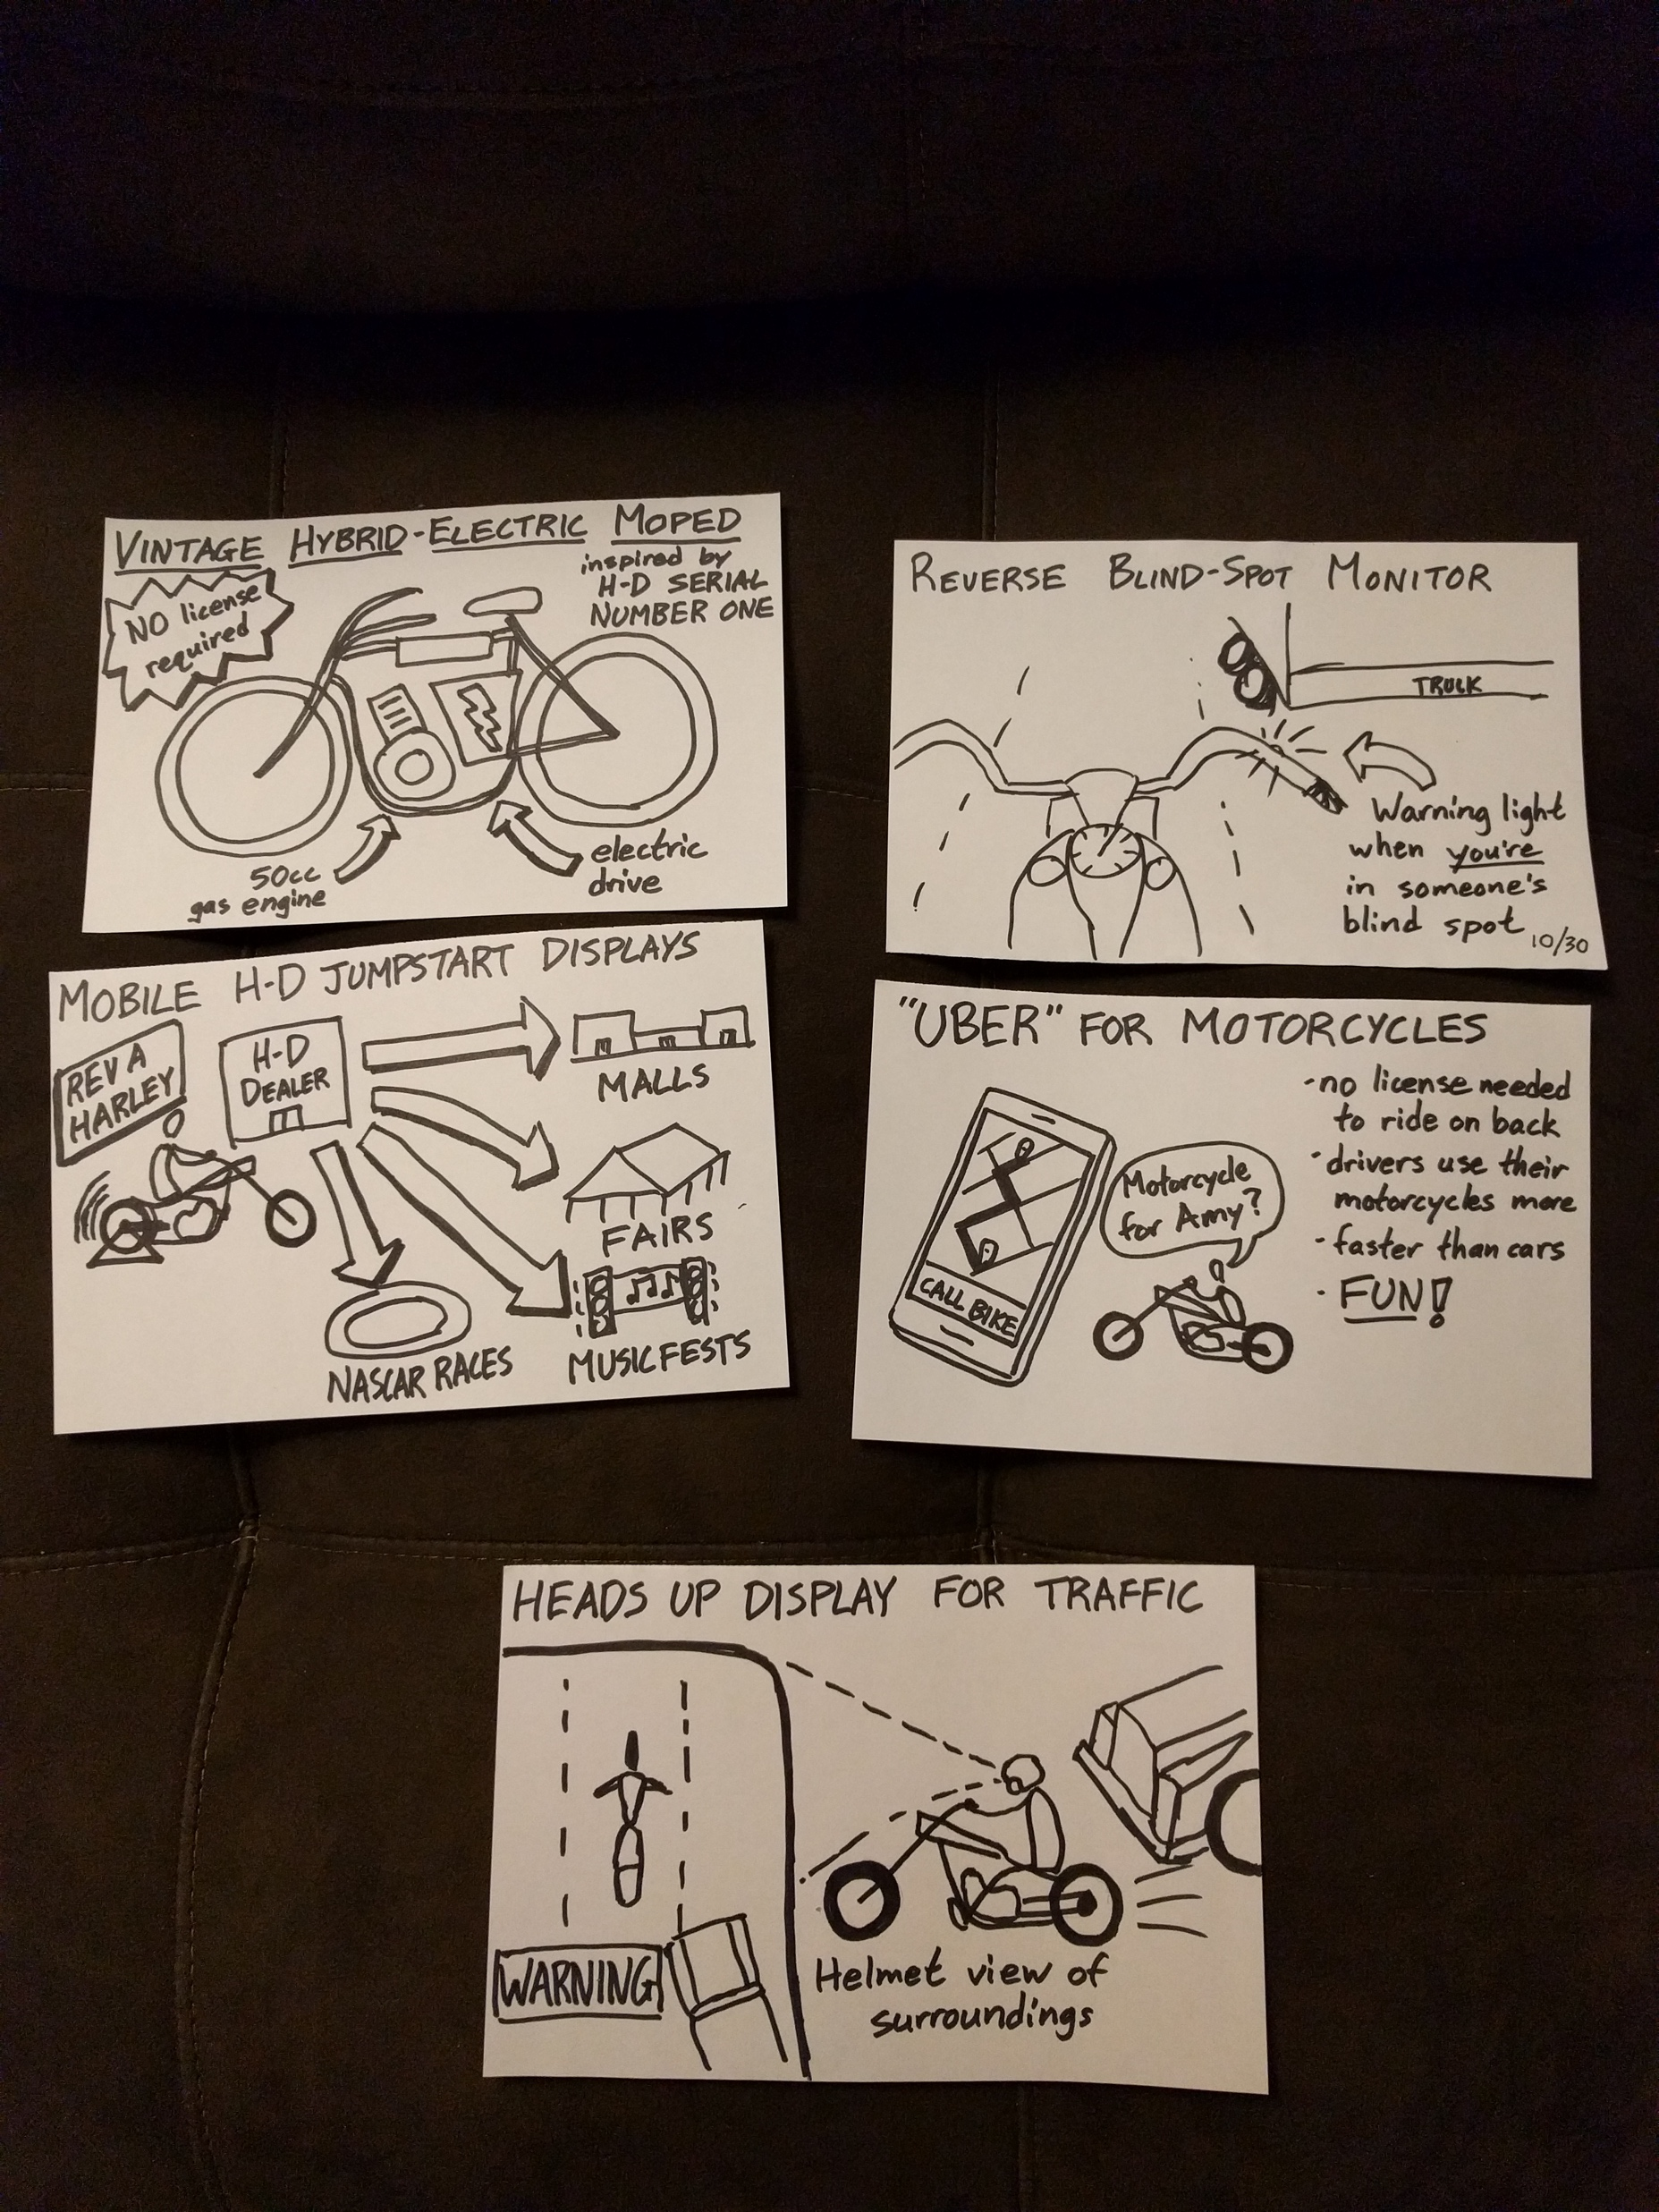
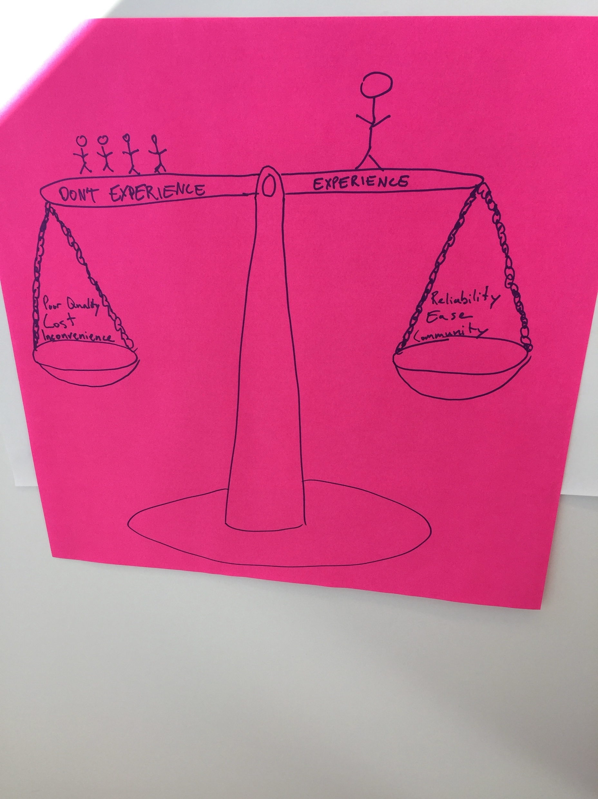
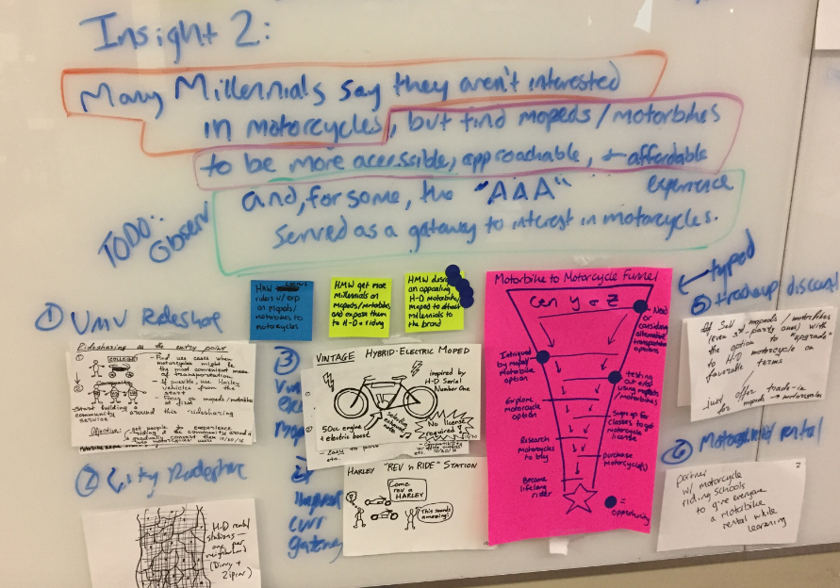

Slide 42
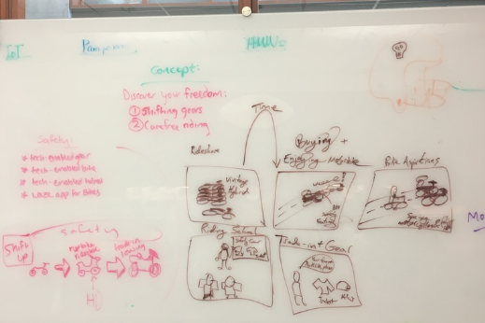

Slide 43
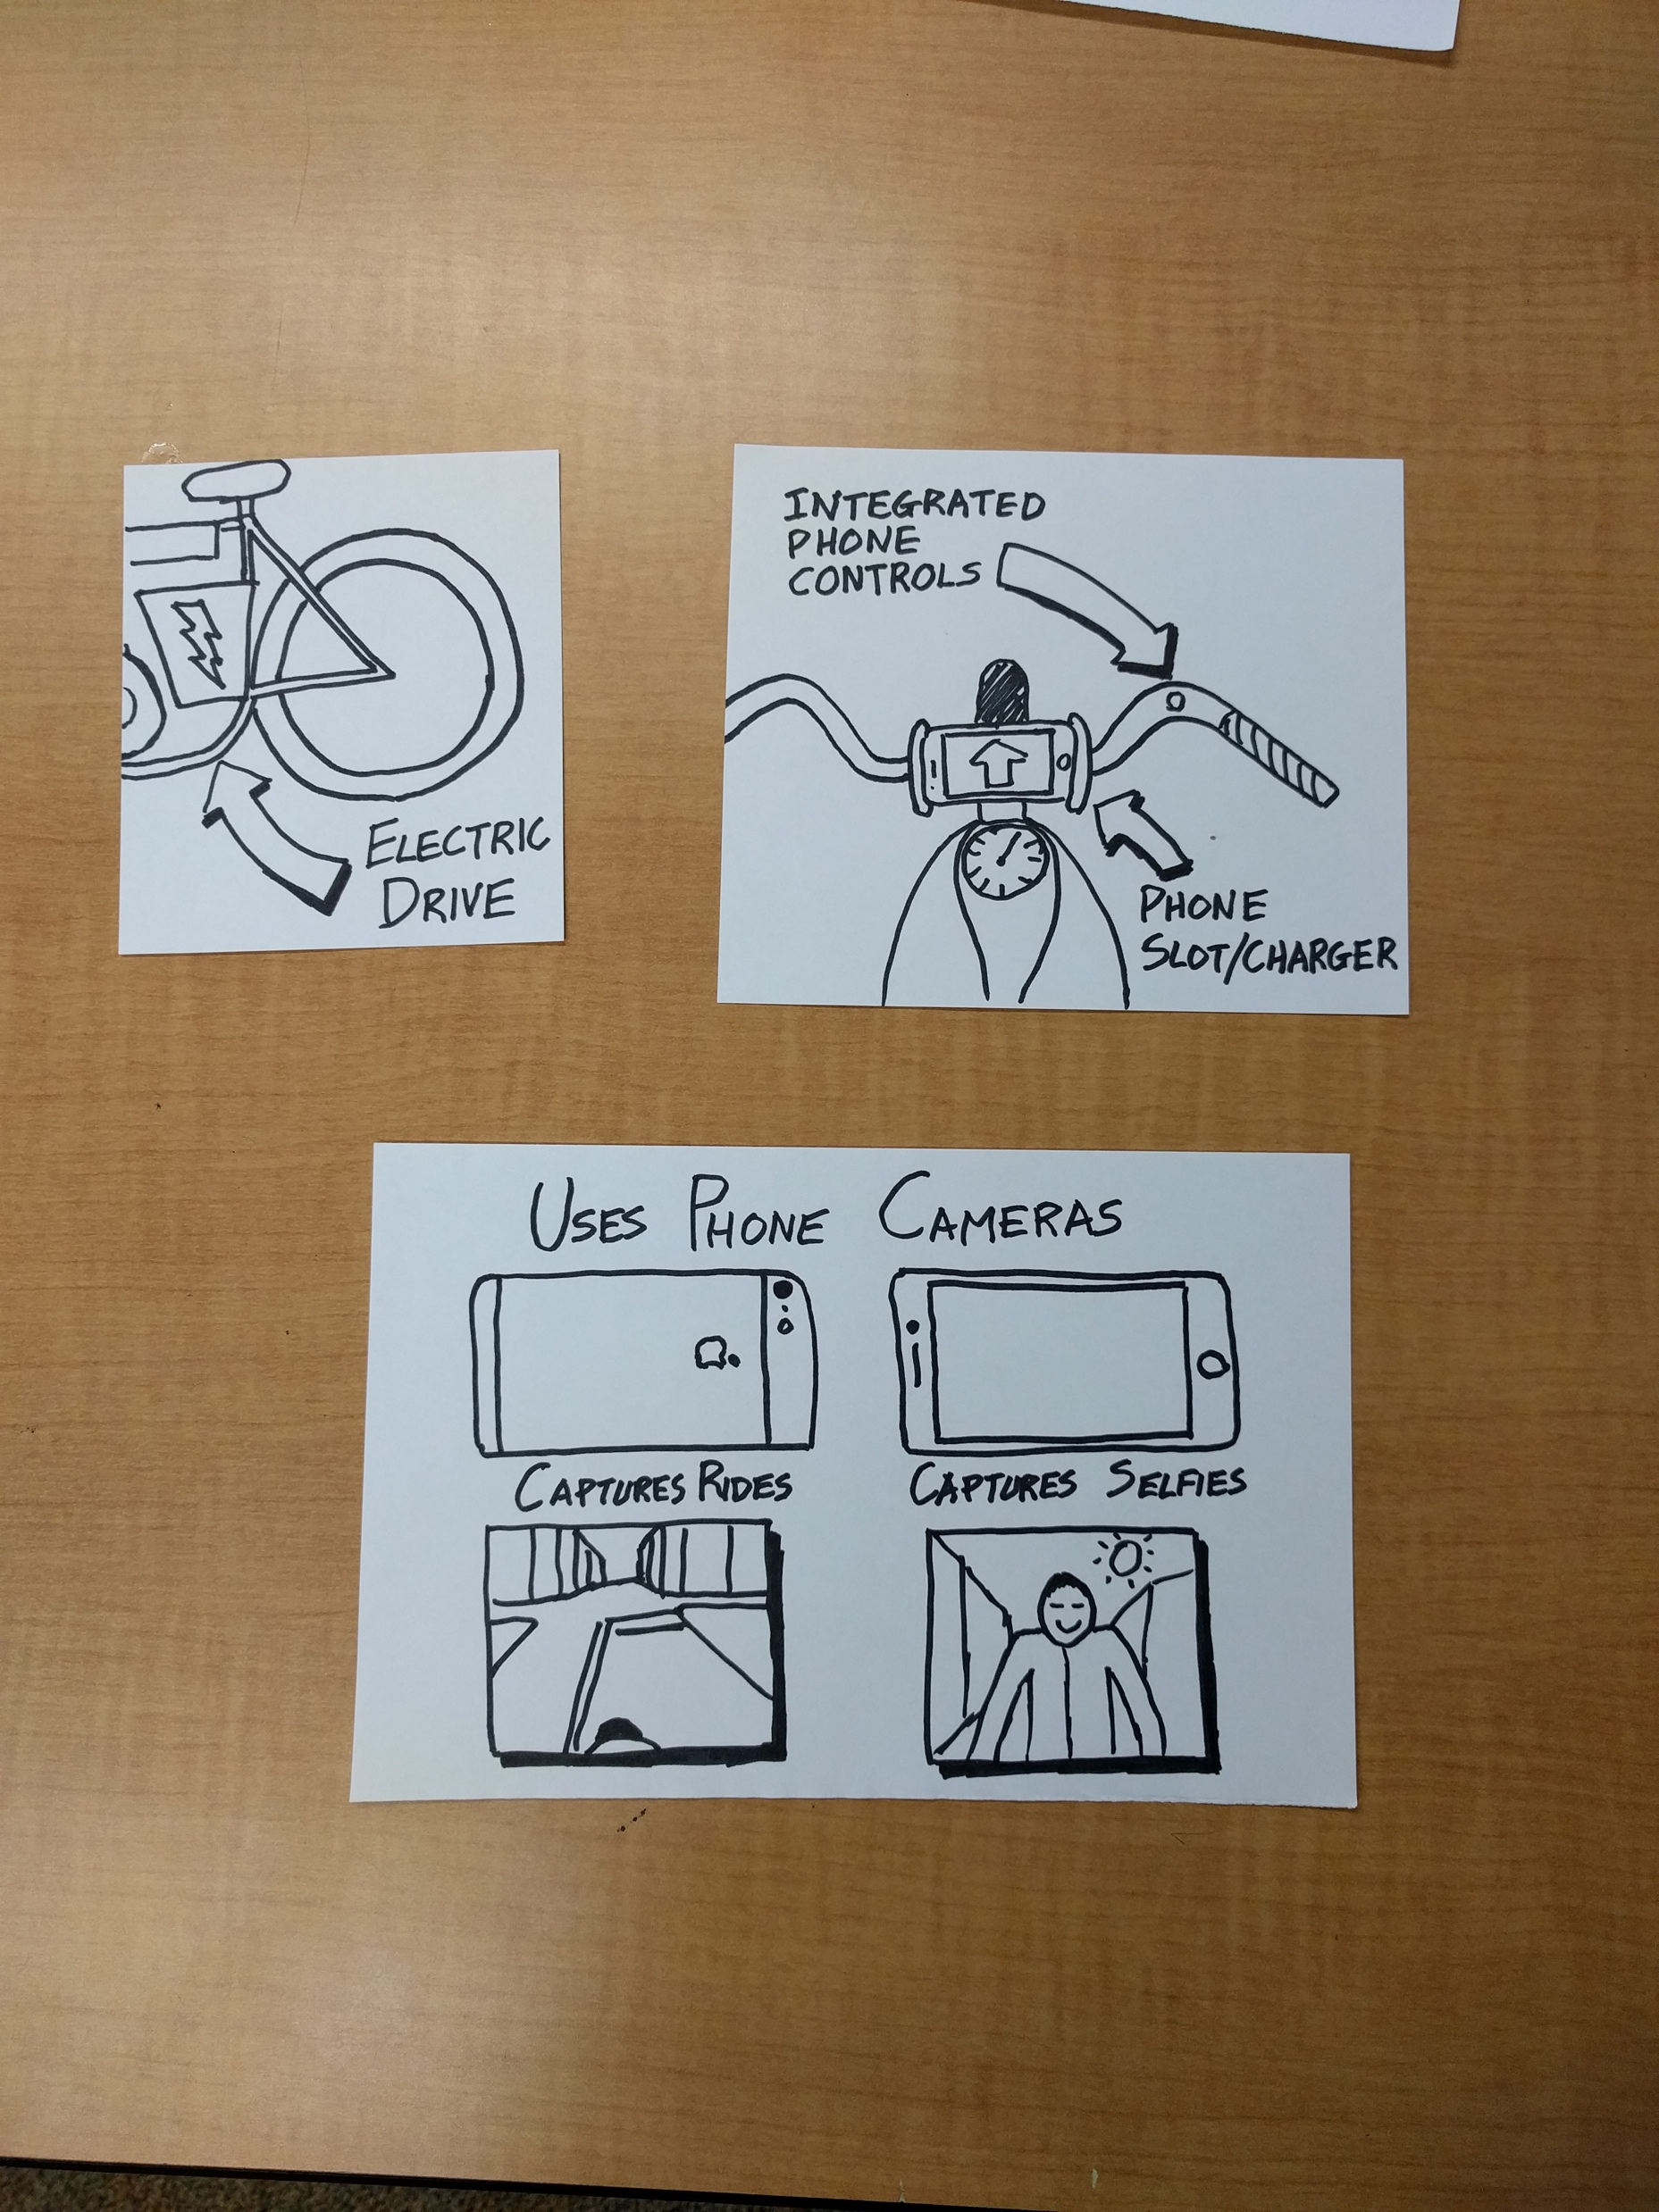
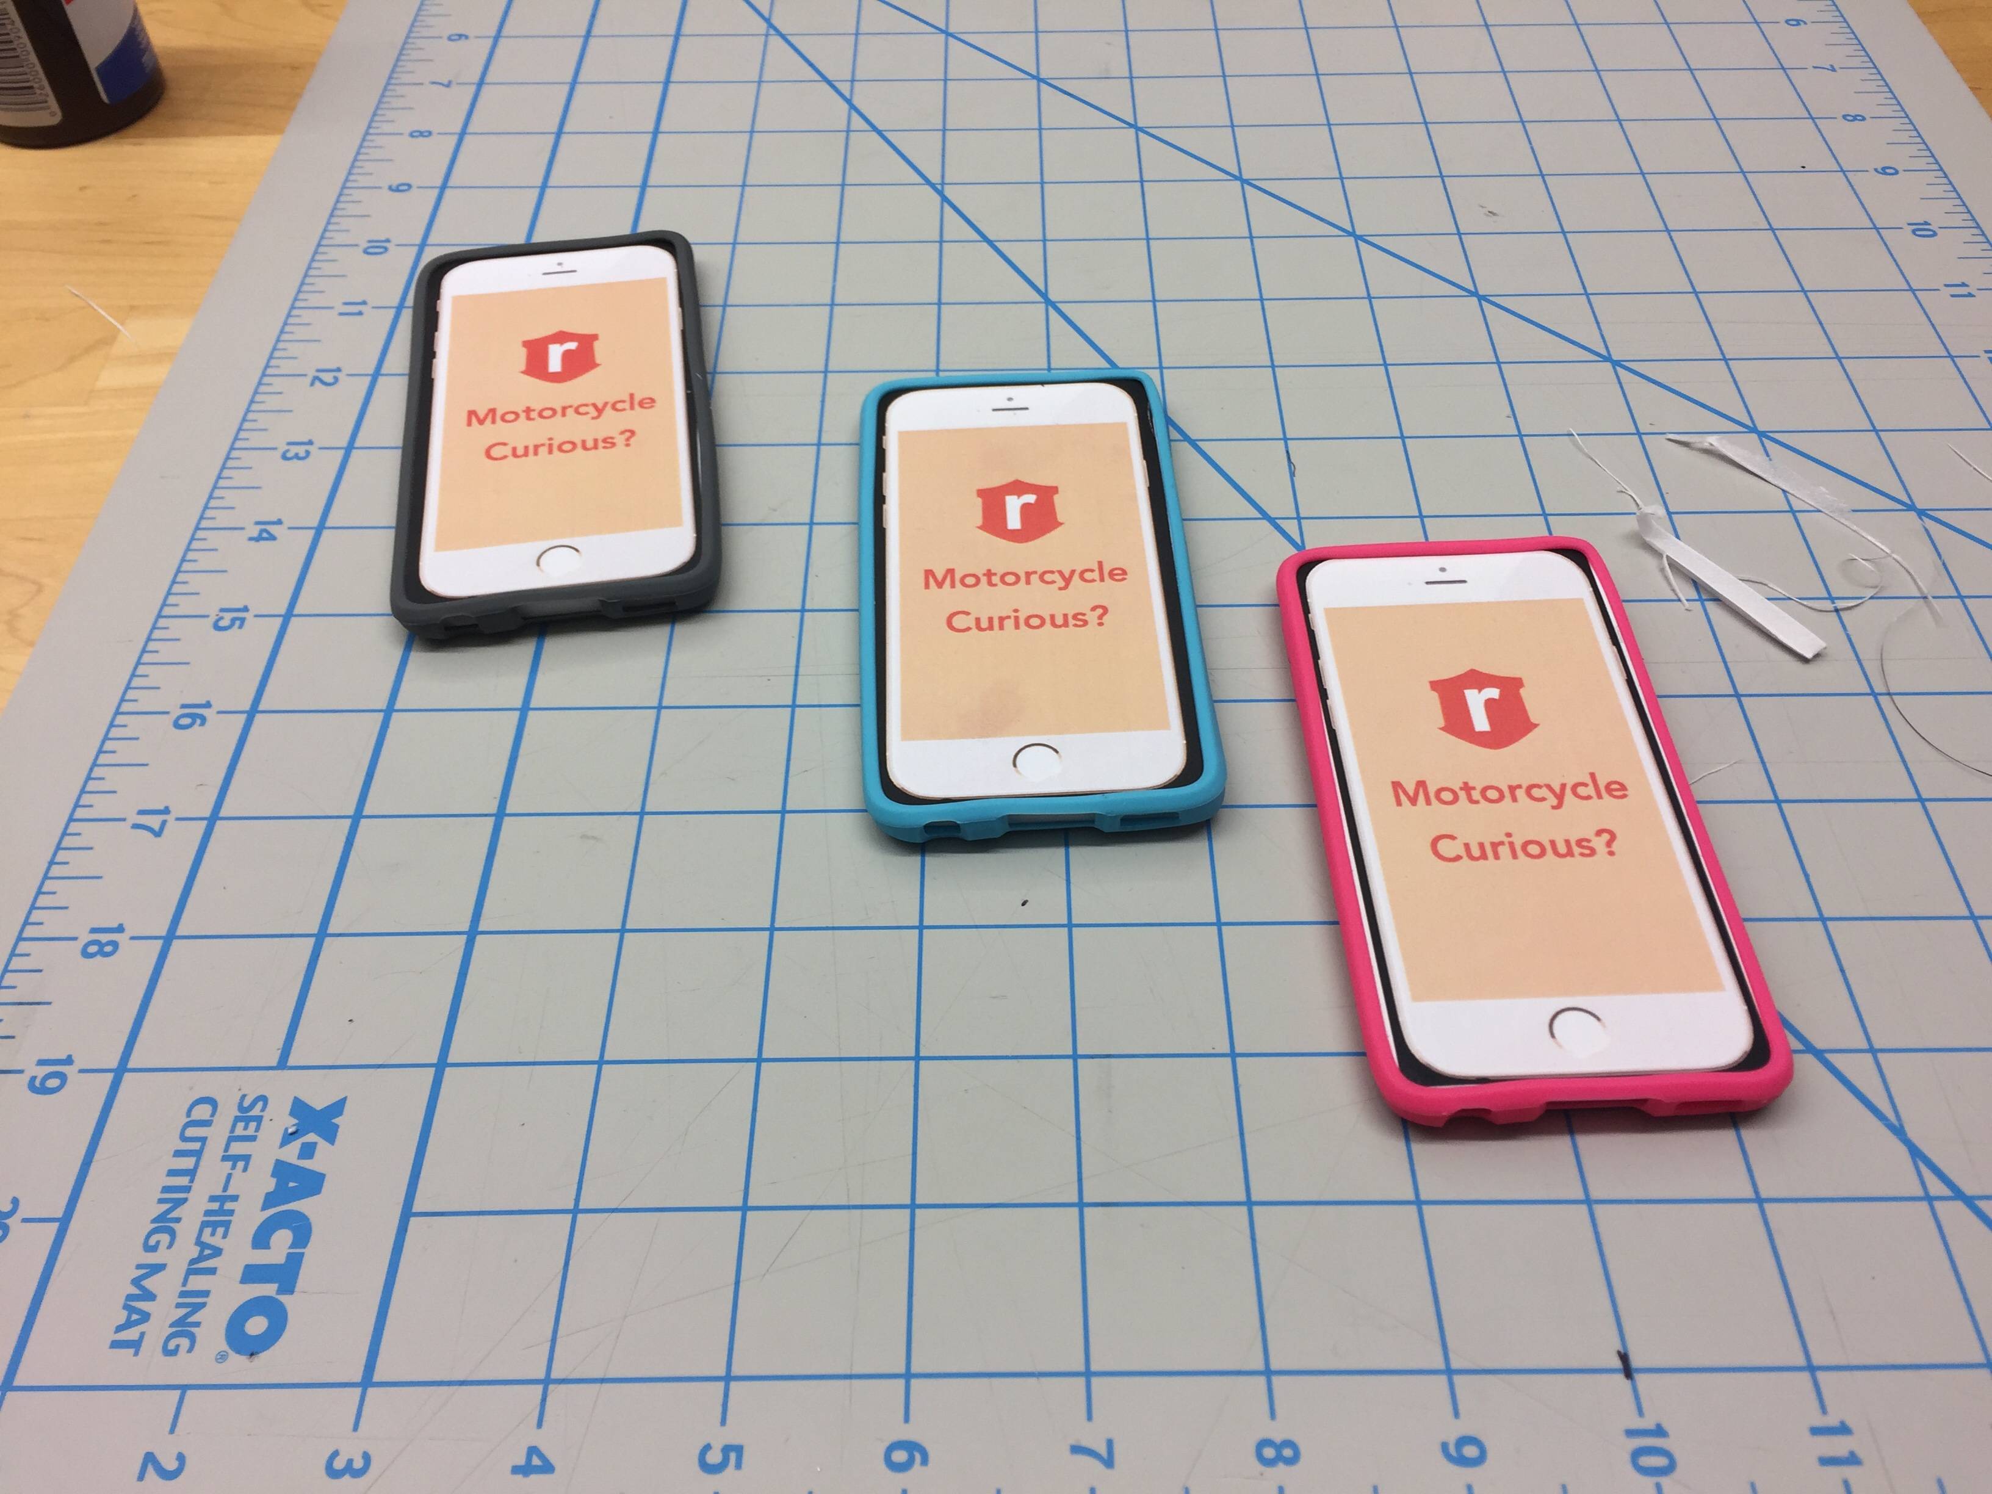

Slide 44
How does motorcycling establish cultural prominence with Generations Y&Z and how does Harley-Davidson capture the leadership role in this movement?

